Slide 1
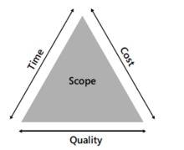
PROJECT SCHEDULING TECHNIQUES
GRP43
Mitanshu Pawan Bhoot C20
Tarun Medtiya C14
Saurabh Chandrakant Rane C73
Sakshi Jitendra Oswal C29
Parth Pawar C56
Automata Software engineering

Slide 2
Outline
1 Introduction to the Project Management
2 PERT (Program Evaluation and Review Technique)
3 CPM (Critical Path Method)
4 Gantt Chart
5 Differences between PERT, Gantt and CPM
6 Duration compression

Slide 3
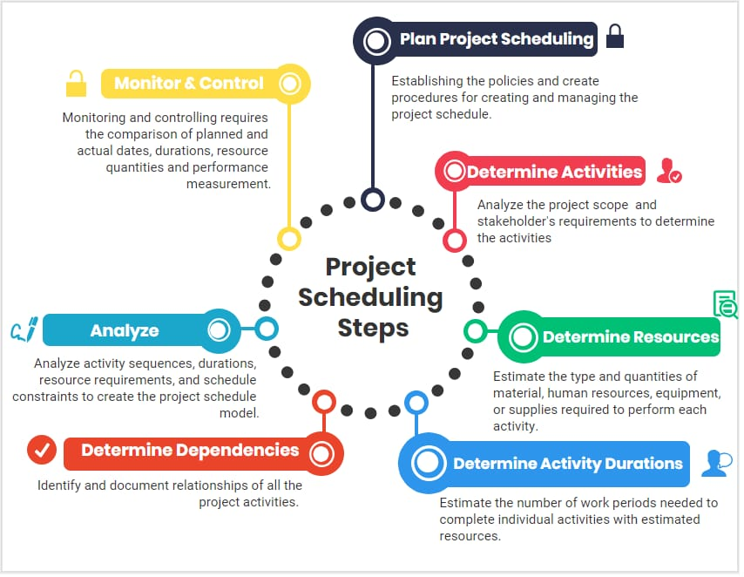

Slide 4
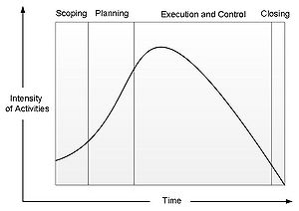
Five Steps in Project Management
1. Scoping
2. Planning
3. Executing
4. Controlling
5. Closing

Slide 5
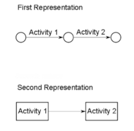
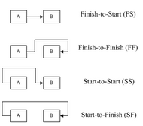
PERT (Program Evaluation and Review Technique)
Activities
Connections (or constraints)
FINISH-START, FINISH-FINISH, START-START and START-FINISH
Preset Date
Calendar

Slide 6
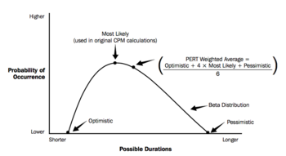
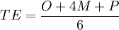
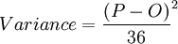
Time estimations
Activity | Optimal Time (weeks) | Medium Time (weeks) | Pessimistic Time (weeks) | Estimated Time (weeks) | Variance (weeks)
A | 1 | 2 | 3 | 2 | 0.11
B | 2 | 3 | 4 | 3 | 0.11
C | 1 | 2 | 3 | 2 | 0.11
D | 2 | 4 | 6 | 4 | 0.44
E | 1 | 4 | 7 | 4 | 1
F | 1 | 2 | 9 | 3 | 1.78
G | 3 | 4 | 11 | 5 | 1.78
H | 1 | 2 | 3 | 2 | 0.11

Slide 7
Step to construct a PERT Diagram
STEP 1 – Arranging the activities
STEP 2 – Going onward (from the start to the end)
STEP 3 – Going backward (from the end to the start)
STEP 4 – Calculating the slack

Slide 8
CPM (Critical Path Method)
CRITICAL ACTIVITY has SLACK=O
To create a CPM diagram the following elements are needed:
List of the activities that are needed to complete the project
Duration of each activity
Dependencies between the activities.

Slide 9
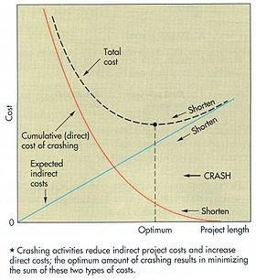
Trade off between costs and time
TOTAL COST = DIRECT COSTS + INDIRECT COSTS
Direct costs
Employees and workers salaries that work within the project
Materials
Outsourcing activities
Software
Machineries
Indirect costs
Salaries of the administration employees
Salary of Top Management
Costs of commercial activities

Slide 10

Example of PERT/CPM
Activity | Predecessor | Duration (weeks)
A | / | 5
B | / | 4
C | A | 3
D | A | 4
E | A | 6
F | B, C | 4
G | D | 5
H | D, E | 6
I | F | 6
J | H,G | 4

Slide 11
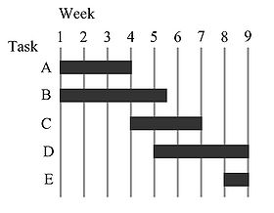
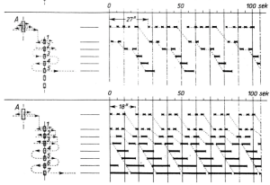
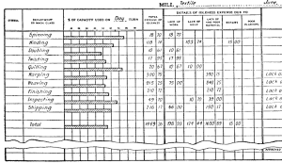
Gantt Chart
Before him, during the 1890s, a Polish engineer named Karol Adamiecki, already used a sort of Gantt chart for the steelworks he was running. But as it can be noticed from the Figure 13, his Chart was pretty basic and rough than the one developed by Gantt

Slide 12
Input for Gantt Chart
To create the Gantt Chart only four elements are needed
Project Scope
Responsibilities
Available Resources
Schedule Management System
Activities, their timing and sequences

Slide 13
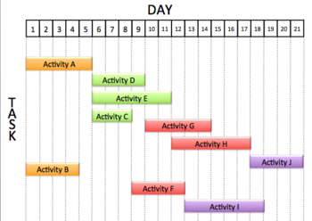
Example of Gantt Chart
Activity | Predecessor | Duration (weeks)
A | / | 5
B | / | 4
C | A | 3
D | A | 4
E | A | 6
F | B, C | 4
G | D | 5
H | D, E | 6
I | F | 6
J | H,G | 4

Slide 14
Differences between PERT, Gantt and CPM
 | PROS | CONS
PERT | Smart tool for projects with high number of activities, data and dependencies. It shows dependencies between the activities. | Longer time to develop Not readable from everyone. (experts only) It facilitates the identification of the critical path and makes it visible. The lack of a timeframe makes it harder to show the development status.
Gantt | Effective tool for small projects. Simple: everyone can read it and make it. Easy to read from all the stakeholders. It could be used to show fragments/portions of big projects previously elaborated with PERT. Powerful visual communication tool. Short time to make. Useful tool to see the development of the project. Useful too to reallocate resources among activities. | It doesn't show activities' dependencies It cannot be used for project with large number of activities and dependencies. It need constant updates (changes to the schedule require a redrawing of the chart). It doesn't highlight the activities with the highest risk of failure or delay.
CPM | Identifying critical activities is fundamental to be aware of possible delays. TIME=MONEY. This tool is really useful for planners to forecast the length of the project taking into account that critical activities could delay it. It makes dependencies visible. | For large projects it's difficult to handle the dependencies and calculating the slack. In this case it is possible to use software that calculate everything. It does not account for resource and resource allocation.

Slide 15
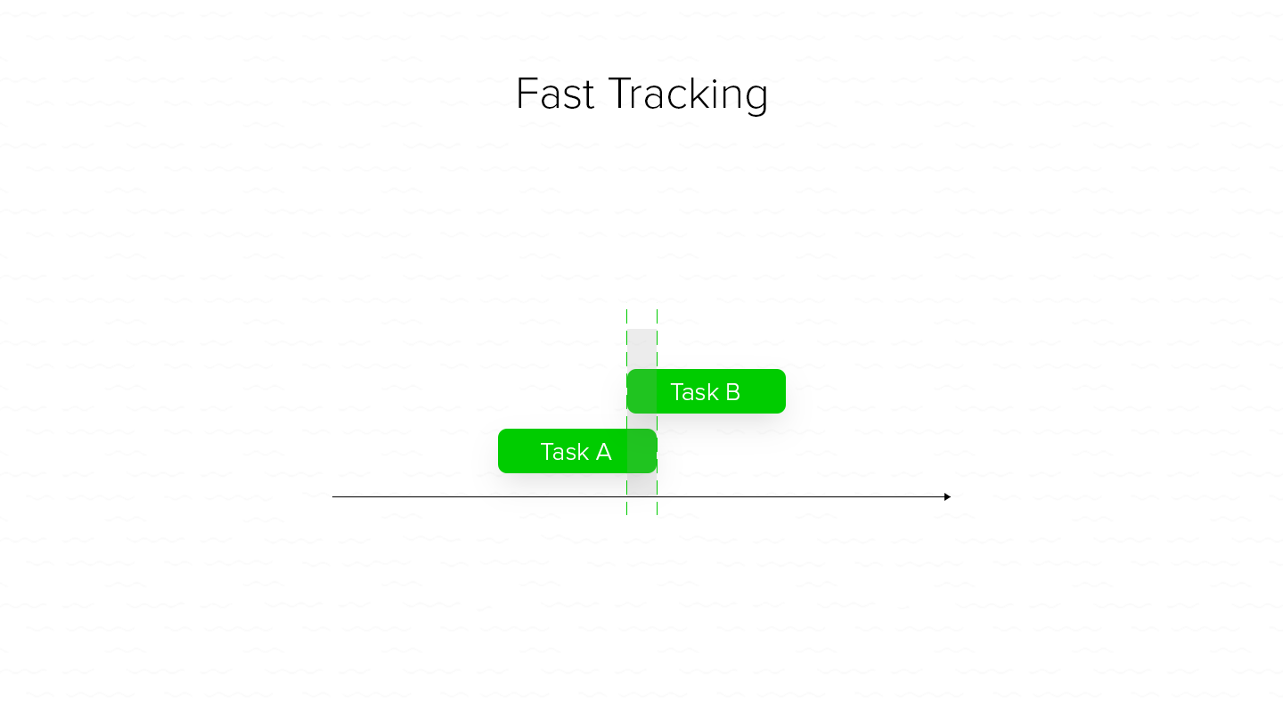
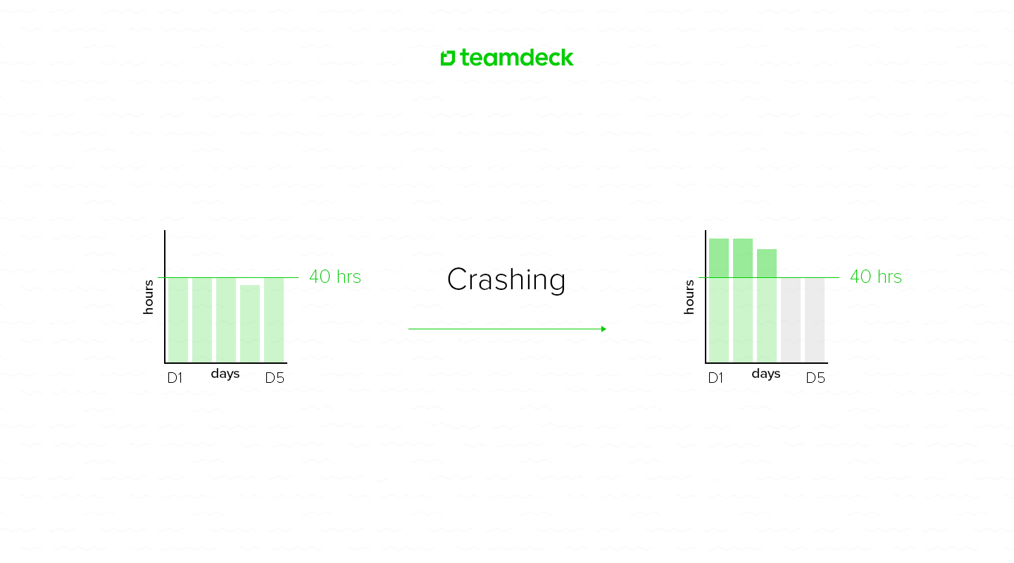
Duration compression
There are two techniques that you may apply: fast tracking and crashing

Slide 16
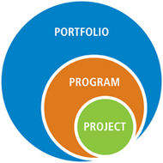
Benefits of using scheduling techniques in Project Management
Project: "A temporary endeavor undertaken to create a unique product, service or result."
Program: "A group of related projects managed in a coordinated way to obtain benefits and control not available from managing them individually. Programs may include elements of related work outside of the scope of discrete projects in the program."
Portfolio: "A collection of projects or programs and other work that are grouped together to facilitate effective management of that work to meet strategic business objectives. The projects or programs of the portfolio may not necessarily be interdependent or directly related."

Slide 17
Thank You

